Slide 1
SENIOR2SENIOR

Slide 2
About Tri-Co Connections
Tri-Co Connections, an LLC of Tri-County Rural Electric Cooperative Inc., will construct 3,250 miles of fiber line over the course of six years to 16,600 members.
Our territory covers about 5,000 square miles in north central Pennsylvania. Our service area is primarily in Potter, Tioga, Bradford and northern Lycoming Counties. We also extend into parts of Cameron, Clinton and McKean Counties.
The cost of the entire project is about $77 million, with much of that coming from state and federal grants and loans.
Tri-Co Connections, through Tri-County Rural Electric Cooperative, already owns the poles that will be used to build the fiber network. We also have the trust of our membership. Electric cooperatives are positioned, more than anyone else, to provide solutions for developing high-speed Internet networks in our sparsely-populated rural markets.
2

Slide 3
Building Out a FTTH Project in Rural PA
Challenges:
42% Seasonal / Second Homes
5.8 Homes Per Mile (vs. 1216 homes per square mile in Phoenix)
13.34 people per square mile (vs. 2797 people/square mile in Phoenix)
40% + Seniors
Distance / Density / Terrain
Cost - $80 million
-Government subsidies
3

Slide 4
Senior2Senior Program
OPPORTUNITY:
Assist Seniors in learning how to use a computer when fiber broadband reaches their area
Utilize local high school students in volunteering to provide on-site support to each of the Seniors who participate in the course
Take advantage of the five Senior Centers in Potter County, where we started our fiber project
4

Slide 5
Strategy
• Utilize the five Senior Centers for training
Utilize the CTC – Seneca Highland Career and Technical Center’s Trainer, and high school students as tutors
Utilize the local banks as trainers in usage of online banking and cybersecurity
The course consists of 8 one-hour courses:
- 20–25 Seniors per class
- Transportation by Potter County Human Services on Aging
-Graduates receive certificates and additional benefits
4

Slide 6
Benefits of S2S Program
Basic computer skills, digital literacy and cybersecurity
Staying connected to family and friends via Skype, Facebook, email
Utilizing telemedicine (health care from home) and communicate with local doctor
Accessing online government tools such as social security, insurance and Medicare
Use online banking for services such as Direct Deposit’
Work from home, part-time
Shop from home
Improve hand-eye coordination using strategy-based video games
Online education
7

Slide 7
Partnerships / Steering Committee
Potter County Education Council
Seneca Highlands Career Technical Center (CTC)
Potter County Human Services Area Agency on Aging
Local banks (funding, training, computers)
Local hospital (funding, technical support)
County Commissioners
Local school districts
8

Slide 8
Goals
Train 80 – 100 Seniors in first year
Duplicate program in 7 counties
Attract major sponsors (AARP, State Grants)
Not just invest in the fiber project – invest in our community, Seniors, low income, uneducated
9

Slide 9
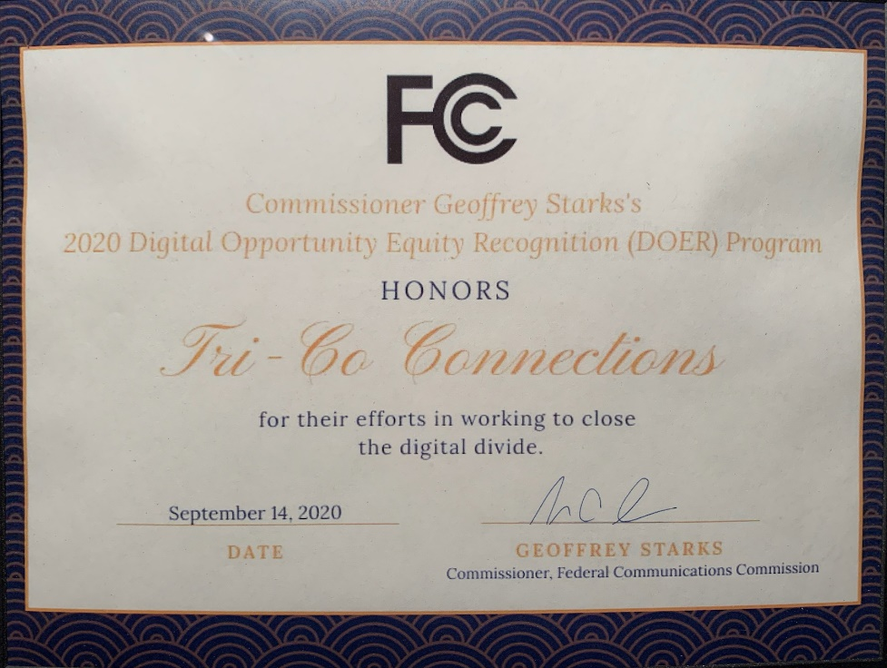
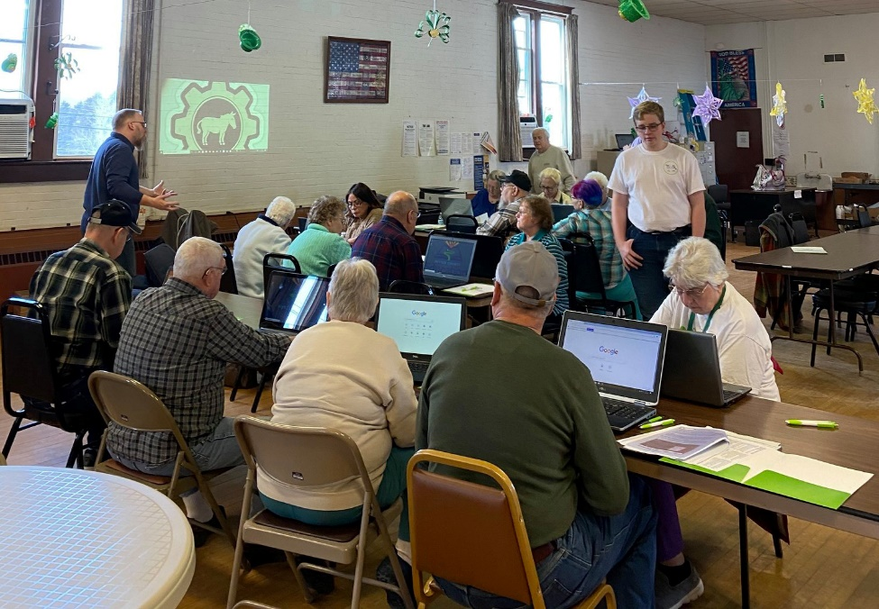
The Senior2Senior Program was awarded the DOER ( ) by the Federal Communications Commission.
6

Slide 10
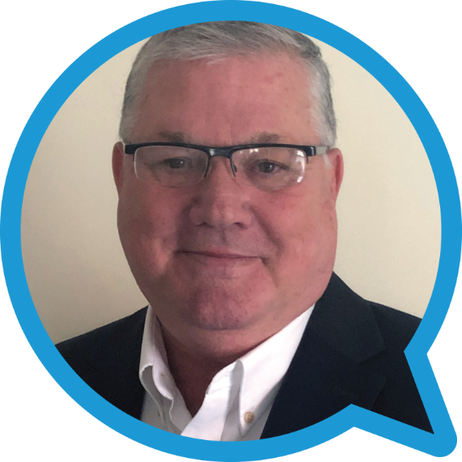
For further information:
Bill Gerski
SVP Business Development, Tri-Co Connections
billgerski@tricoconnections.com
M: 702-493-6142
6

Slide 11
THANK
YOU

