Slide 1

5G Reality
Making 5G Happen TM
Presented by:
Ricardo Platt
12/13/2019

Slide 2

What is 5G?
5G is the next (5th) generation of communication networks
1G
2G
3G
4G
5G
Time 70’s – 80’s 90’s – 04 04- 10 10’s - Now future
Data 2kbps 64kbps 2Mbps 100Mbps + 10Gpbs-100Gpbs
Technology Analog Digital CDMA/EDGE Wi-Fi/LTE New WWWW
Lots of Data

Slide 3
What is 5G?
5G is the next (5th) generation of communication networks
Phase 1 Upgrade of 4G technology - incremental innovation
Will stay at frequencies < 6 GHz
Modification of current RF packaging architectures
Minimal change
Phase 2 5G mmWave technology - disruptive innovation
Introduction of mmWave frequencies >24 GHz
Adoption off new packaging architectures and platforms
Extensive design changes and new materials required
You need a new Phone

Slide 4
What does 5G offer?
  Much faster and wider bandwidth
  Reduced latency (time of response)
  High data rates
  High system capacity
  Massive device connectivity
Amazing User Experience

Slide 5
How does it work?
  5G will use small cell concept
  MIMO – (multi input/multi output) technology which uses multiple antennas to simultaneously receive data
  The network will operate at higher frequencies (millimeter wave) where wider lots of band width exists
Think WiFi in Steroids

Slide 6
Where is the industry now?
  Much hype, limited real information
  Mostly sub 6GHz (Phase 1)
  Carriers still trying to make sense of costs of rolling out new infrastructure (small cell) model
  Communities working through entitlement issues (zoning, public misconceptions, processing permits)
User and public expectations vs. slow rollout

Slide 7
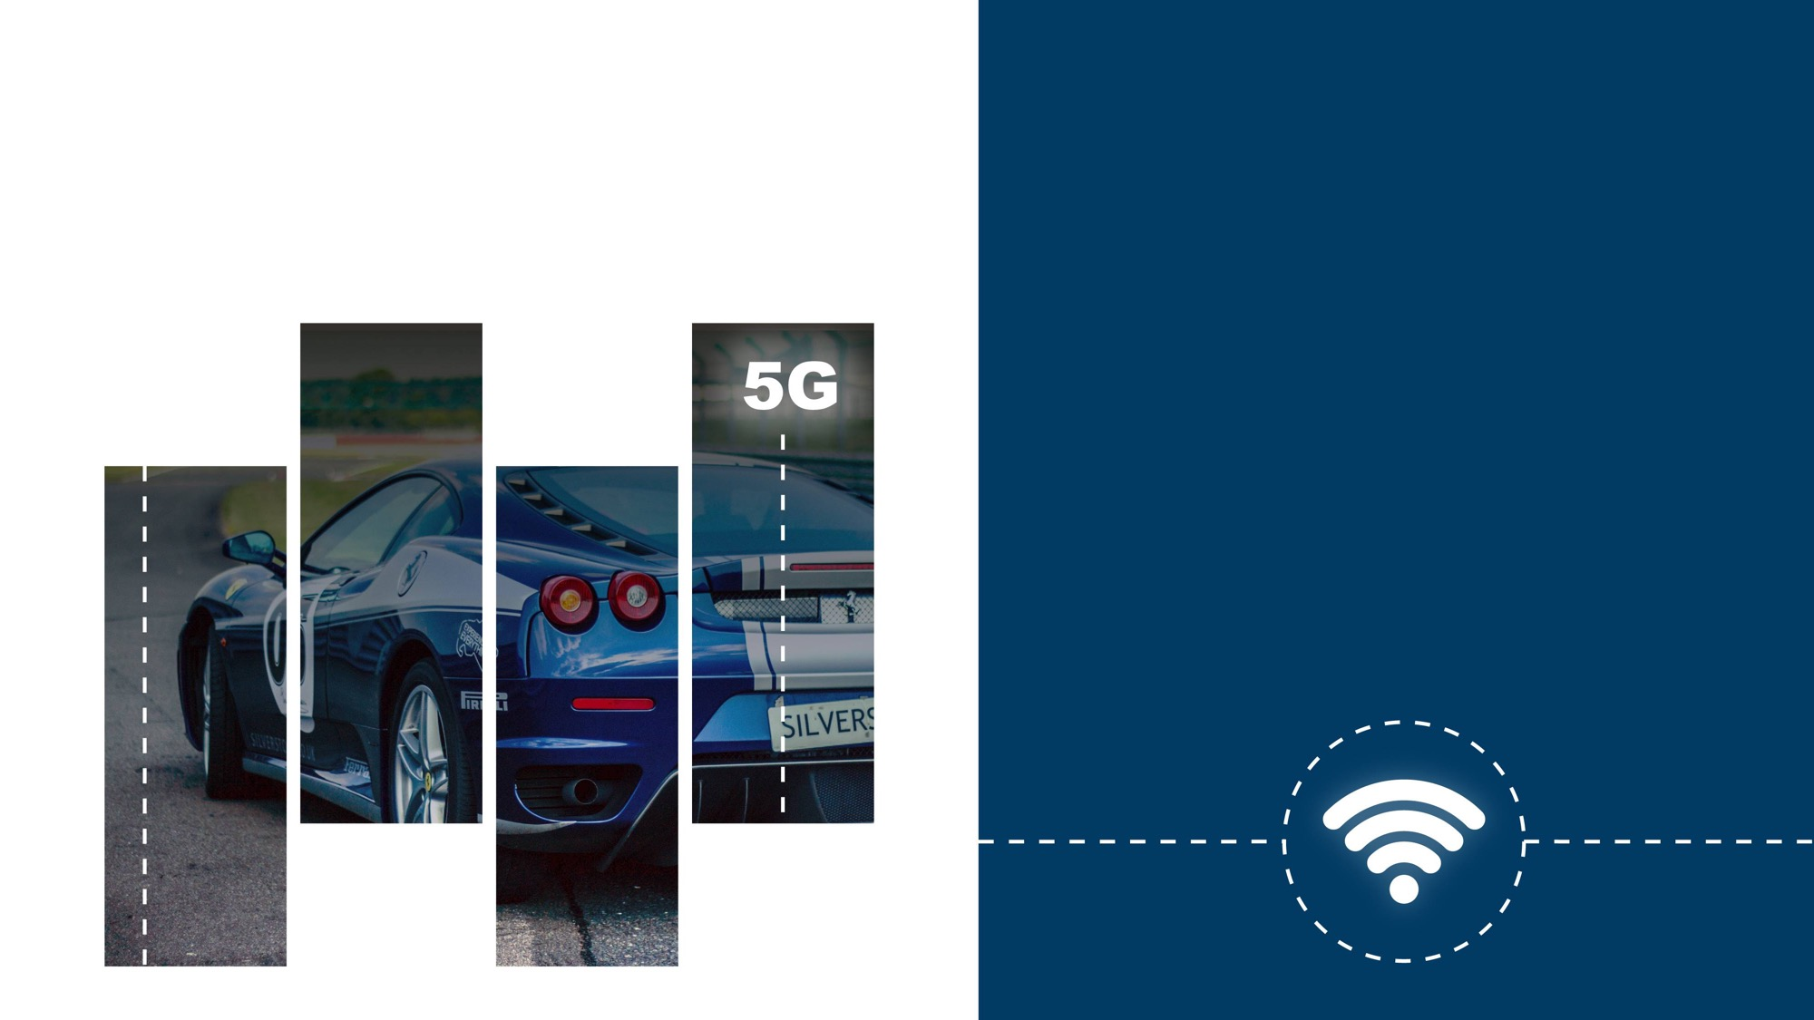
OUR MISSION
Transform the way people and things communicate with our innovative wireless products
for 5G and beyond.

Slide 8
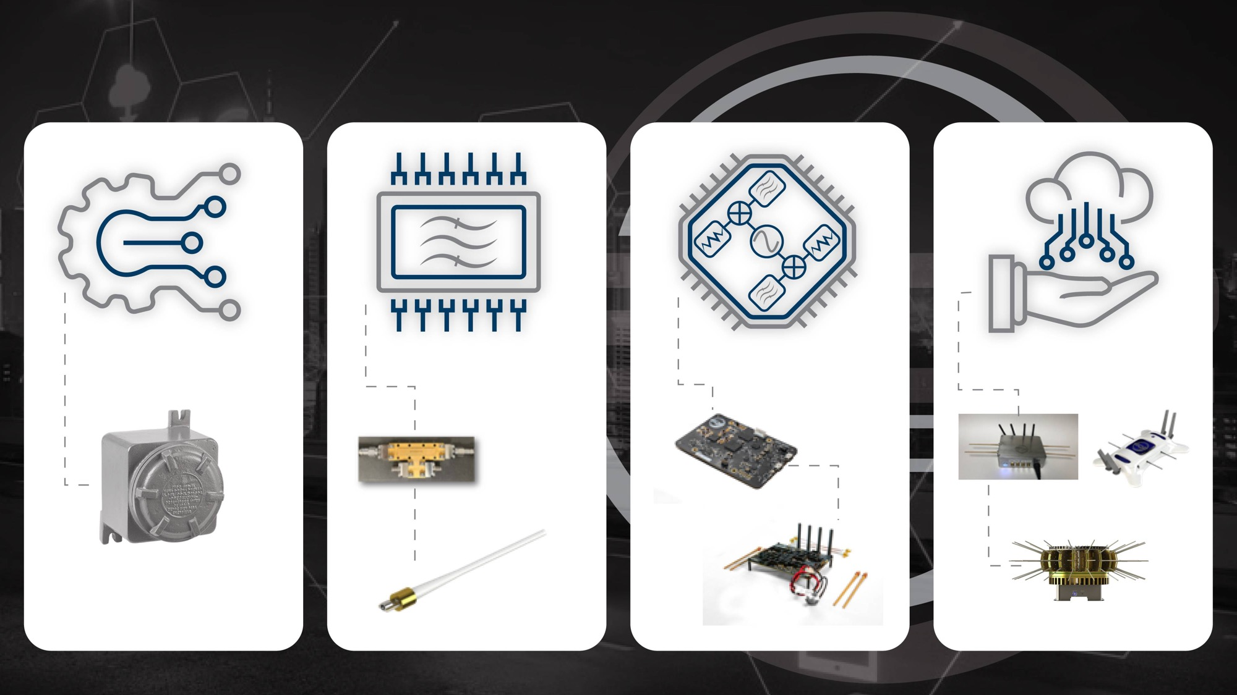
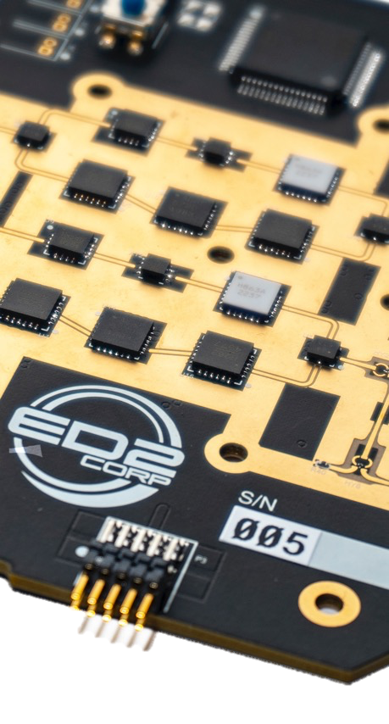

Products
Sensors
Filters
RF Electronics
Wireless Solutions

Slide 9
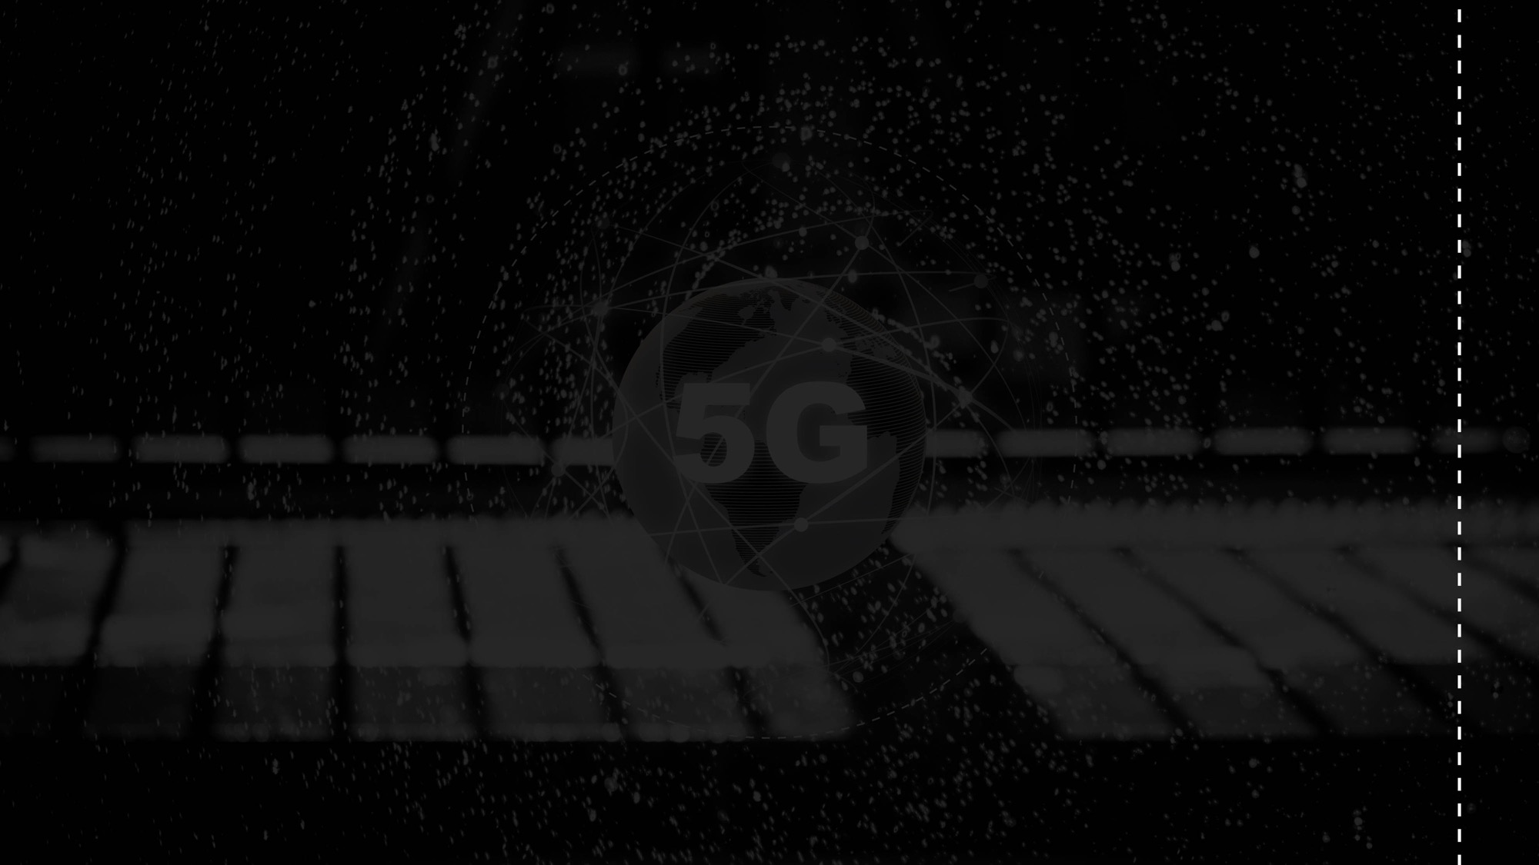
Thank You
For more information contact:
Ricardo Platt
ricardo@ed2corp.com
Making 5G Happen TM

