Slide 1
January 23, 2020
Rural Broadband Funding
ARIZONA COMMERCE AUTHORITY
Jeff Sobotka – VP & State Broadband Director

Slide 2

ACA Mission
The mission of the Arizona Commerce Authority is to grow and strengthen Arizona’s economy and facilitate the creation of quality jobs for its citizens by attracting and supporting business in high-growth industries throughout the state. Why? Because a vibrant, diverse, state-wide economy means increased opportunities for our citizens.
It’s about helping people.
Attract
Recruit out-of-state and international companies to establish operations in Arizona
EXPAND
Work with existing Arizona Companies to grow their businesses here and beyond
CREATE
Partner with entrepreneurs to create new Arizona businesses in targeted industries

Slide 3
2019 Strategy
Meet with Arizona Cities/Towns
Understand Local Issues & Existing Assets
Develop a Local Broadband Action Plan
Bring Partners to the Table
Assist with Broadband Funding Opportunities
  Rural Broadband Development Grant (RBDG)
  USDA Re-Connect Program
Promote Duplicatable Wins

Slide 4
ACA Broadband Update, 2019
Established broadband unit within ACA
Developed broadband grant
Worked w/State Land to create new ROW policy
Engaged w/APS on aerial deployments
Recruited two new carriers to the market
Working w/electrical co-ops to deploy fiber
Provided assistance to 5 applicants for USDA Re-connect grants
Established Broadband Action Teams (BATs)
Established State Broadband Working Group w/other state agencies

Slide 5
ACA Broadband Update 2020
Awarded $3M in grant funding
  ‘A’ Grant-Construction-Awardees
    Payson (Sparklight)
    Bullhead City (Mohave Elec. Co-Op)
    Page (Comnet)
  ‘B’ Grant-Planning-Awardees
    Coconino County
    St. Johns
    Springerville
    Gila County

Slide 6
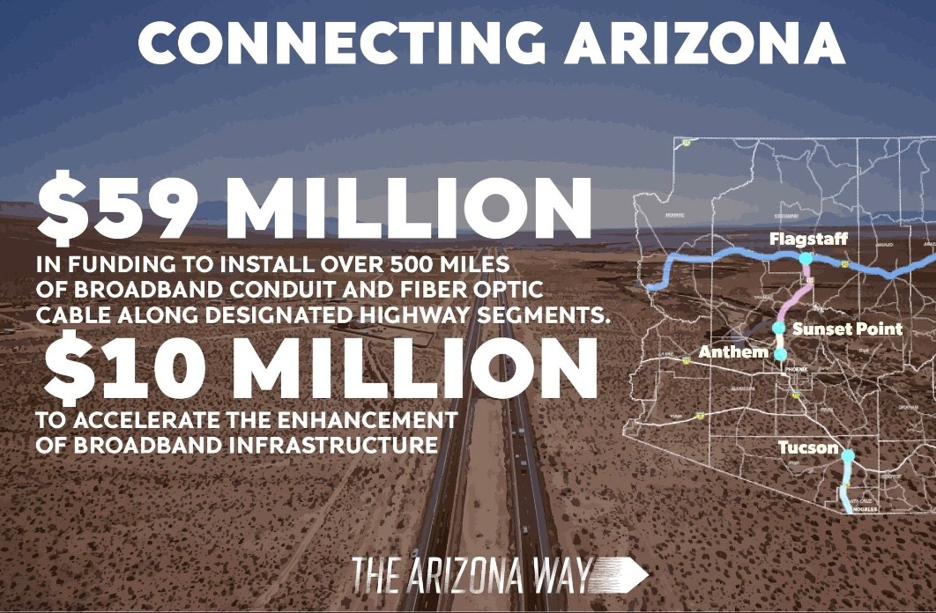
2020 State of the State Address

Slide 7


2020 Federal Funding Programs

Slide 8
Thank You!
JeffS@azcommerce.com
azcommerce.com/broadband

