Slide 2
Privately Held & Family-Owned
Founded in 1898 by Ohio Governor James M Cox
120+ Years (4 Generations) of Innovation & Technology Leadership
$7B Annual Revenue
World leader in vehicle remarketing services and software for automotive dealers and global consumers
NEW
VENTURES
$12B Annual Revenue
Largest privately held telecom company in the U.S.
Cleantech | Healthcare | Esports

Slide 3
Cox business STRATEGIC INVESTMENTS
Remote monitoring, control and insight for smarter business environments
Managed cloud services powered by RapidScale technology enable businesses to simplify their IT operations and benefit from enterprise-level technology.
Advanced convention center services, custom managed WiFi networks, high capacity bandwidth, free-to-guest TV, digital signage and location-based advertisement services
Operational and logistical support for Remote Patent Monitoring (RPM) programs
Design and management of complex data network services for hospitality industry
Reliable network services for schools, carriers, data centers, hospitals, and enterprise business customers
Custom IoT solutions allowing businesses and cities to connect and manage assets for operational efficiencies and enhanced customer experiences

Slide 4
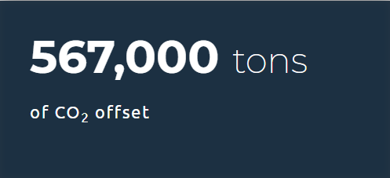
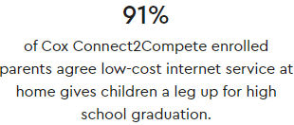
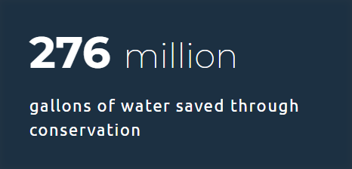
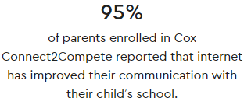
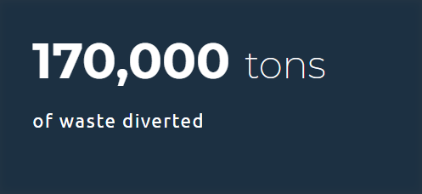
Community investment
Youth and Education
Broadband Adoption
Diversity and Inclusion
Sustainability

Slide 5
TECHNOLOGY

Slide 6
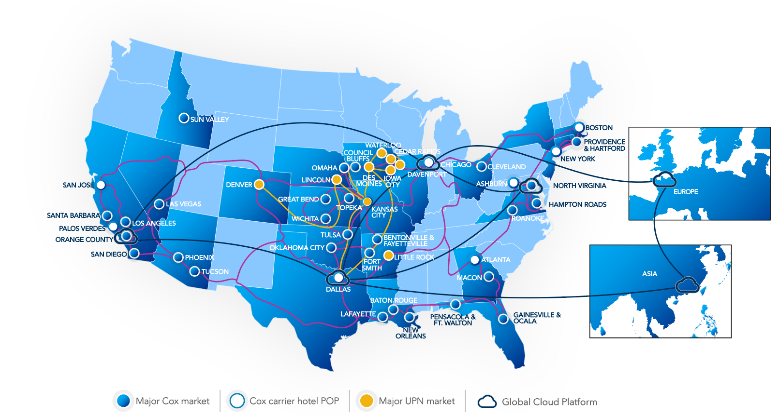
Cox Business Global Network
Cox Business Proprietary & Confidential

Slide 7
Cox Business CORE Solutions
INTERNET
& TRANSPORT
CLOUD
VOICE
TELEVISION
Cloud Desktop (DaaS)
Cloud Server (IaaS)
Cloud Recovery
Cloud Backup
Cloud Security
Office 365
Premise Security Solutions
Cox Business Internet
Cox Fiber Internet
Cox Optical InternetSM
Managed Router+ Security
Managed WiFi
Over 500,000 WiFi Hotspots
Metro Ethernet
Optical Wavelength Solutions
MPLS IP-VPN
SD-WAN
Hosted IP Voice Lines (Cox Business VoiceManagerSM)
Cloud-based Hosted PBX (Cox Business IP Centrex)
Unified Communications
SIP Trunking
PRI and Digital Trunk Services
Digital and HD video services
Private Office and Public Viewing
Business Packages:
Sports / News & Info
Bulk Video
HD Free to Guest

Slide 8
Education Solutions

Slide 9
We are committed to bridging the digital divide for low income families with school aged children in our community

Slide 10
Connect2Compete Overview
Program Benefits:
$9.95 a month
No deposits, no contracts, no social security number required
Free Installation, free wifi modem rental
Eligibility:
Have a K-12 student in household
Are a new Cox Internet customer
Household participates in government assistance programs:
National School Lunch Program, Head Start, SNAP, TANF, WIC, LIHEAP, or live in public housing

Slide 11
COVID-19 Response
Cox outdoor Wifi Hotspots open to keep public connected
Suspending late fees for customers who express inability to pay
Cox Cares Act Solutions for Education to help schools cover the cost of student internet access

Slide 12
Active Products
Solutions in response to the CARES Act funding allocation needs.
Elements
Speed
Price
Notes
Connect2Compete®
NSLP, SNAP, TANF, Public Housing; no C2C last 90 days
25 Mbps / 3 Mbps
$9.95 / Month; $0 NRC
No Overage
Unlimited usage
Cox Internet
Cares 25 (Starter) - NEW
Cares 50 (Essential) *
25 Mbps / 3 Mbps
50 Mbps / 3 Mbps
$30 / Month; $0 NRC
$40 / Month; $0 NRC
Self-Install; $100 Pro Install
Overage*: $10/50GB over 1.25TB OR $50 Unlimited
Right of way agreements
MDU Bulk WiFi
Subsidized by School District
Varies by property
Varies by property
Engage MDU Team
CB Managed WiFi
Subsidized by School District
Can be in each MDU or around MDU Campus
All Existing Speed Tiers
System Pricing/ Month / AP
= Add On Features
Authentication
Content Filtering
School SSID
$2.50 / Month / Device
$5.00 / Month / Device for both
ADFS (Active Directory) only
* All Cox Internet Tiers are eligible to receive the CARES subsidy

Slide 13
CARES ACT Residential Internet Solutions: Speed Increase
PRODUCT | Description | SPEED | cost
Cox Connect2Compete | Qualified offer for National School Lunch (NSLP), SNAP, TANF, Public Housing No data overages; WiFi modem rental included | Temporarily: 50 Mpbs/3 Mpbs through 6/30/21; 25 Mpbs/3 Mpbs thereafter | $9.95/month* *Customer must qualify
CARES Starter Internet | Non-qualified offer for customers who do not meet C2C eligibility (including students and faculty) Modem rental included; includes 1.25 TB data (data overages are $10/50 GB – paid by end user) | Temporarily: 50 Mpbs/3 Mpbs through 6/30/21; 25 Mpbs/3 Mpbs thereafter | $30/month
CARES Essential Internet | Non-qualified offer for customers who do not meet C2C eligibility (including students and faculty) Modem rental included; includes 1.25 TB data (data overages are $10/50 GB – paid by end user) | 50 Mpbs/3 Mpbs | Temporarily: $30/month through 6/30/21; $40/month thereafter

Slide 14
District Process
When a school chooses to pursue Cox’s solution for remote learning, this is how they will engage.
1. Selection
Select Authentication and Content Filtering
Provide list of addresses
2. Data Prep
Equipment model, speed
Prepare address disposition
3. Parent Portal
Families agree to subsidy and sign-up for service (if applicable)
Share with families Parent Portal
Check Serviceability
Confirm plans to pay a subsidy per student/family
Self-Install kit
Avoid Downgrades
School Portal (Phase 1) targeting release first week of August
Parent Portal targeting release first week of August
School District
Cox
School District

Slide 16
Managed device as a Service
What is RapidScale Managed Device as a Service for Education
Hardware + Support + Warranties
All at One Affordable Predictable Monthly Price
RapidScale’s All Inclusive Device as a Service offering provides you with a predictable monthly price, ensuring you have device choice and scalability, in addition you receive 24 / 7 US-based support and a 3-year warranty covering accidental damage, loss, and theft protection. (terms and conditions apply)
Choose from 3 great Original Equipment Manufacturer “OEM’s” (LG, Samsung, HP)
Choose from Different Devices (Laptops, Chromebooks & Tablets)
Includes Imaging, Kitting, and Shipping
Includes 24 / 7 RapidResponse Support
Includes 3-year warranty covering accidental damage, loss, and theft protection
Fixed Monthly Price (based on 3-year subscription)
Integration with optional RapidScale services (M365, IDaaS, DaaS, SD-WAN)

Slide 17
Device Selection
OEM | Specifications | Device Type | LTE Enabled
LG | LG GPad5: 10.1 FHD screen, 4 GB RAM, 32 GB ROM, Android version 9 (Pie). | Tablet | Yes
HP | HP Chromebook 11A G8 EE, A4-9120C APU (1.6 GHz, 1 MB L2 cache), 4 GB 1866 (on Mb), 32GB eMMC, 11.6 LED HD SVA AG | Chromebook
Samsung | Samsung Chromebook: 12.2 1920 x 1200, Intel Celeron Processor 3965Y, 4GB, 32GB, Chrome, Stealth Silver, Verizon. | Chromebook | Yes
HP | HP PB640G5 i5-8265U 14 8GB/256 PC Intel i5-8265U, 14.0 FHD AG LED UWVA, UMA, Webcam, 8GB DDR4, 256GB SSD, AC+BT, 3C Batt, FPR, W10 Pro64 | Laptop
Samsung | Samsung Galaxy Book Ion: Intel Core i7-10510U, 16 GB memory, 512 GB SSD, Win10 Pro. | Laptop

Slide 18
Device pricing
Price List
Category | Name | RapidScale SKU | Type | Price
Device | LG Tablet with LTE | 6500-DEVICE-LG-TAB-LTE | Recurring | $25.00
Device | HP Chromebook | 6500-DEVICE-HP-CRBK | Recurring | $22.00
Device | Samsung Chromebook with LTE | 6500-DEVICE-SAMS-CRBK-LTE | Recurring | $38.00
Device | HP Laptop I5 | 6500-DEVICE-HP-LPTP | Recurring | $68.00
Device | Samsung Laptop I7 | 6500-DEVICE-SAMS-LPTP | Recurring | $87.00
Setup | BARK Opt. out of Service | 6500-DEVICE-BARK-EXC-S | Setup | $0.00
Setup | Google Device License | 6500-DEVICE-GOOG-S | Setup | $40.00
Shipping | RMA-Standard-US-Shipping ¹ | 6500-STD-USSHIPPING | Setup ² | $0.00 / $16.00
Shipping | RMA-Expedited-US-Shipping ¹ | 6500-EXD-USSHIPPING | Setup ² | $0.00 / $22.00
¹ – Shipping is billable per device shipped. If a replacement device is shipped out and an old device shipped for return, this equates to two shipping events.
² - $0.00 parts chargeable per RMA instance, per device

Slide 19
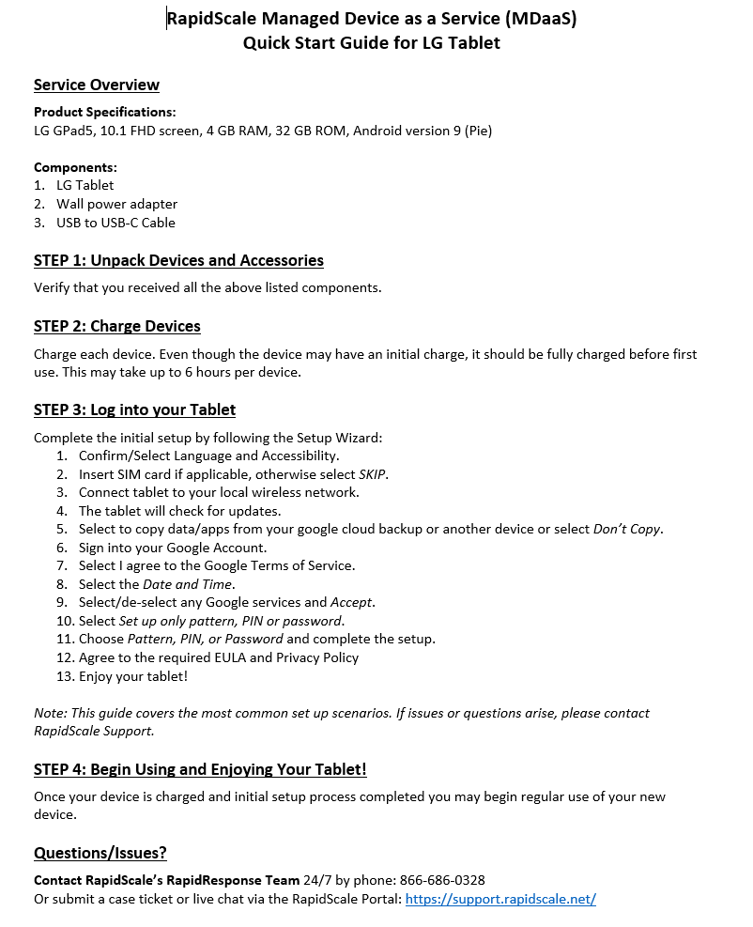
Device imaging, kitting, and shipping
Pre-installed software for laptops
Windows 10 7-Zip Adobe Reader Google Chrome Microsoft Edge – Chromium | Mozilla Firefox NotePad++ Applicable Drivers Optional add-on: Microsoft Office 365 suite (purchased separately)
Bark (Installed) as part of setup
What’s in the box
Device
Charger
1-page QuickStart Guide (see example to the right →)
Shipping
New devices: Shipping is included
RMA devices: Customer is billed by RapidScale for return shipping

Slide 20
Cox Wireless Network Product Set
Cox has a broad set of wireless capabilities to meet customers needs – Private Networks are simply another option to help address customer pain points
Wireless Networks ‘Toolbox’
Managed WiFi
LoRa/NB-IoT
DAS
MPN
Cox Mobile Private Networks
Source: Interviews with Cox stakeholders, Arthur D. Little analysis
Notes:
Viewed as another tool in our quiver
Managed WiFi, DAS, LPWAN
To help the customers enable the solutions that they need to operate their businesses most effectively & efficiently

Slide 21
Mobile Private Networks : Value Chain
There are multiple disparate (and often complex) parts to building an end-to-end private network
Hardware / components
Private / public comm. infrastructure
Network design and deployment
Network operation
Network services
End user device(s)
OTT services
Routers / switches
Base stations / access points
Gateways
Chipsets
(Access to) connectivity assets incl. spectrum, fiber
Software / physical interfaces (protocols, towers, etc.)
Network design services
Project management
Physical asset deployment and configuration
Monitoring & analytics
Maintenance
Management
Data (VPN)
Internet (peering)
Security
Other service platforms
Voice
Messaging
Mobile phones
Servers
Computing equipment
L3-VPN
IoT platforms
Apps
(1) Market Sizing is exclusive of Network Services.

Slide 22
Full Stack Solution : Cox + Partners
Cox owns many key network capabilities and has a variety of partnerships to enable us to stitch together a complete end-to-end solution
Hardware / components
Private / public comm. infra.
Network design and deployment
Network operation
Network services
End user device
OTT services
Cox
Spectrum
B
G
Network operation services
Backhaul
C
Depends on use case / customer need
I
Vertical / use case oriented devices and services
D
Public
mobile network connectivity
Partners
A
RAN equipment
E
SAS
Network design & deployment services
H
Mobile core
F
Source: Arthur D. Little analysis

Slide 23
Why Cox? : Cox Advantages
Cox has a number of inherent advantages over other Private Network providers
Advantage: | Description: | Advantage:
PAL Licenses | Cox owns at least 2 PAL licenses (20MHz+) in almost all of the counties in which it operates | Guarantees spectrum access and reliability; especially valuable for outdoor and/or mission-critical networks
Fiber Network / Backhaul | Cox owns a wireline fiber network in each of the markets in which it operates | Allows Cox to provide end-to-end transport of data -- single provider for network management and problem resolution
Network Management Capabilities | Cox has in-house network management resources + Cox NOC to enable a fully managed solution | Cox can deliver a tailored management solution (from ‘light-touch’ to ‘white-glove’) depending on customer needs
Broad Set of Solution Partners | Cox has built partnerships across the entire Private Networks ecosystem – from equipment providers to network design/deployment to vertical applications | Allows Cox to be the single point of contact to stitch entire solution together for customers
1
2
3
4
Source: Arthur D. Little analysis

Slide 24
Smart Communities Solutions

Slide 25
COMMUNITY CHALLENGES
Ensuring public safety
Containing electricity costs
Maximizing asset value for other city services
SMART COMMUNITIES SOLUTIONS
Light housings to support sensors for traffic, weather, air quality and more
Motion-sensor or network-controlled light activation to provide advantageous electricity pricing
Electric vehicle (EV) charging station hosting to utilize light pole and power source
DATA USE CASES
Pedestrian and vehicle traffic, parking, weather and air quality
Metrics for ROI calculation and future planning
First responders and law enforcement
Tourist information and routes
LIGHTING

Slide 26
COMMUNITY CHALLENGES
Controlling costs
Reducing congestion in high traffic areas
Assisting motorists who forget parking location
Monitoring parking availability and compliance
Right-sizing roadways and parking facilities
SMART COMMUNITIES SOLUTIONS
Kiosk-housed cameras, sensors and signage for monitoring traffic, gathering data and communicating with the public
Data analytics for strategic planning
Cameras on light poles for monitoring congestion, manipulating light sequencing and improving flow
DATA USE CASES
Tracking pedestrian and vehicle traffic flow for planning
Monitoring dwell time for vehicles at curbside or other strategic locations for congestion relief
Tracking direction of pedestrian or vehicle travel for planning
TRAFFIC

Slide 27
COMMUNITY CHALLENGES
Cost-effective monitoring of public spaces for unsafe activity
Rapid response to unsafe situations
Understanding trends associated with traffic and pedestrian travel, crowds and activities for right-sizing public safety staffing and deployment
SMART COMMUNITIES SOLUTIONS
Traffic monitoring to measure flow, record license plates and detect violations
Video to capture crime in progress or deter crime if lawbreakers anticipate being recorded
DATA USE CASES
Security data for access control and crime prevention
Retail data for staffing and advertising
Traffic data for traffic/parking control and predictive analytics
VIDEO ANALYTICS

Slide 28
Why cox business
LOCAL PROVIDER
INDUSTRY EXPERIENCE
TECHNOLOGY INVESTMENT
STABILITY
SHARED VALUES

