Slide 1
Project 10Million
State of Arizona
William.Davin@t-mobile.com

Slide 2
What is the homework gap?
In the U.S., there are 56 million households with children, and nearly 15% of those homes do not have internet.
Studies show that those students without home internet access have a consistent pattern of lower scores in reading, math, and science.
Empirical research supports a link between student internet access, motivation, engagement, attendance, and academic achievement.

Slide 3
Homework vs. schoolwork gap
2019 In-person classes + Homework
Home internet access need
2020 Online classes + Schoolwork
Home internet access need

Slide 4
Closing the schoolwork gap
We’re committing to help close the homework gap by offering school districts free internet access and mobile hotspots for 10 million eligible households. And, due to COVID-19 many schools are completely online, so we’re offering school districts low-cost options to increased monthly data plans to provide connectivity to their students for free.
$10 billion commitment to internet access and $700 million to Wi-Fi devices
Eligible households receive up to 100GB of FREE internet access each year (1 per household) for five years
Eligible households receive a FREE Wi-Fi-enabled hotspot (1 per household)
Options to address homework and schoolwork gap

Slide 5
Project 10Million
Program Plans

Slide 6
Powering the future of education
Like all T-Mobile customers, Project 10Million recipients will benefit from our expanded network capacity, plus:
5-year commitment
FREE 100GB of high-speed data per year
FREE Wi-Fi-enabled hotspots
Option to purchase program-exclusive Wi-Fi-enabled devices at significantly discounted cost
Web content filtering and malware blocking included
1 per NSLP household
(Within state allotment)
During congestion, Project 10Million customers may notice speeds lower than other customers due to data prioritization. Video typically streams at DVD quality (480p).

Slide 7
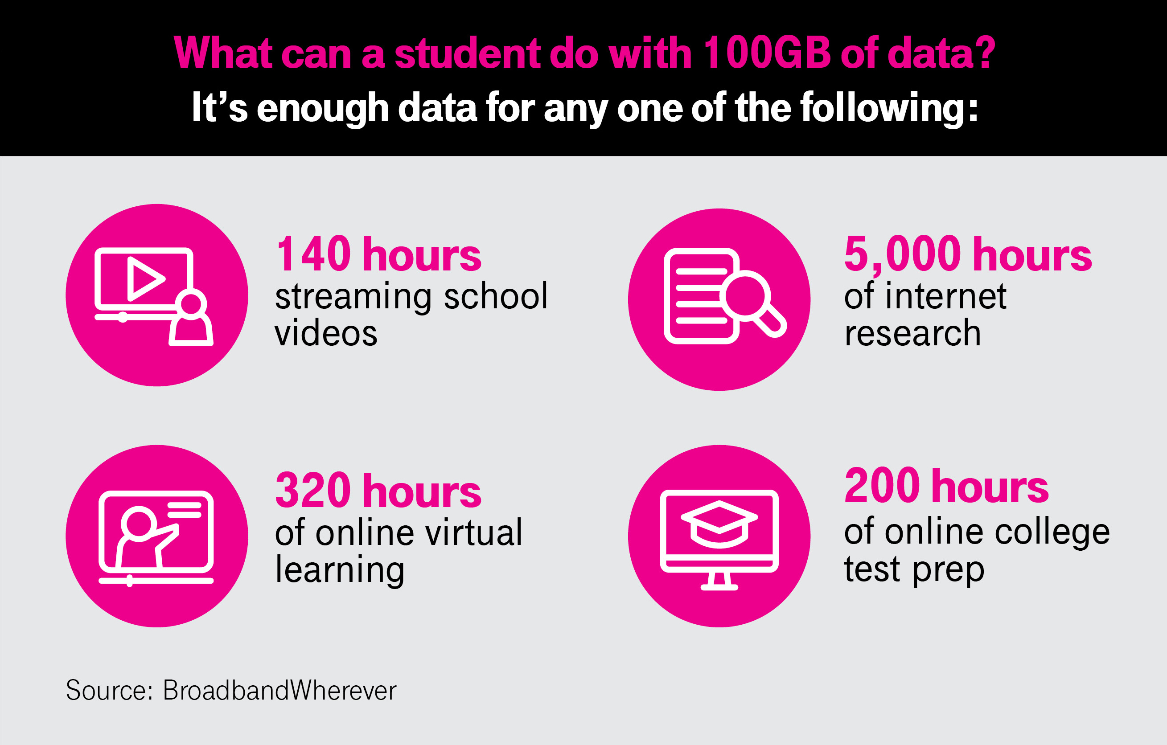
Powering the future
of education
Using 100GB of data, we can open doorways to a wealth of information, educational resources, and tools to increase opportunities for learning in and outside of the classroom.

Slide 8
$0/mo. 100GB data per year
$12/mo.
+ taxes & fees
100GB data per month
$15/mo.
+ taxes & fees Unlimited data per month
More options to increase student success
5-year commitment
Optional plans:
In response to the unique learning challenges students are experiencing in the wake of the COVID-19 pandemic, the Un-carrier is expanding Project 10Million by giving school districts additional plan options with more data to best meet their students’ current needs.
During congestion, Project 10Million customers may notice speeds lower than other customers due to data prioritization. Video typically streams at DVD quality (480p).
1 per NSLP household
Available lines are limited

Slide 9
Discounted tablets and laptops for purchase
For eligible households
100e Chromebook
Coolpad Tasker
$91.⁵⁰ + applicable taxes
$159.⁸⁸ + applicable taxes
10" HD Display (1200 x 800)
Wi-Fi only (AC)
3GB RAM / 32GB ROM
5MP Rear Camera
2MP Front Camera
10" HD Display (1200 x 800)
Wi-Fi only (AC)
3GB RAM / 32GB ROM
5MP Rear Camera
2MP Front Camera
Coming Soon
100e Windows PC
Samsung Chromebook 4
$172.⁵⁰ + applicable taxes
$197.⁷⁷ + applicable taxes
11.6" 16:9 HD Display (1366 x 768)
4GB RAM / 32GB eMMC Storage
720P Webcam
Wi-Fi AC
10" HD Display (1200 x 800)
Wi-Fi only (AC)
3GB RAM / 32GB ROM
5MP Rear Camera
2MP Front Camera

Slide 10
Project 10Million
General Plans

Slide 11
General plans:
$12/mo. + taxes & fees 100GB data per month
2 yr. term
$15/mo. + taxes & fees Unlimited data per month
2 yr. term
$20/mo. + taxes & fees Unlimited data per month
1 yr. term
$25/mo. + taxes & fees Unlimited data per month
Month to month
Increase opportunities for success
Project 10Million plans include the benefit from our expanded network capacity, plus:
FREE Wi-Fi-enabled hotspots
Web content filtering and malware blocking included
During congestion, Project 10Million customers may notice speeds lower than other customers due to data prioritization. Video typically streams at DVD quality (480p).
No eligibility requirements

Slide 12
Participation process
Program participants
General participants
District submits application
Interview call
Network coverage analysis
Eligibility and approval process (1 student ID per eligible household required)
Notification of program participation
Deployment and implementation
District submits application
No eligibility criteria
Network coverage analysis
Notification of program participation
Deployment and implementation

