Slide 1
Arizona broadband stakeholder network municipal networks – what you need to know!
July 26, 2021

Slide 2
Introduction
Panelist:
John C. Lucas - Community Broadband Advocates (CBA) LLC, President
Paul Ross – Phoenix College, Associate Vice President of Information Technology
Moderator:
Karen Ziegler - Karen Ziegler Consulting/Community Broadband Advocates

Slide 3
Agenda
Options for Municipal Networks
Research and Background
Sustainability
Questions & Answers

Slide 4
Types of municipal networks
WHAT ARE MY OPTIONS and WHAT’S BEST FOR MY COMMUNITY?
Carrier Owned
Community Owned
Hybrid

Slide 5
Types of municipal networks
CARRIER OWNED
PROs:
Requires no community involvement or management
Funding is general managed by the carrier
Maintenance, repairs and servicing are provided by the carrier
All customer support is provided by the carrier
CONs:
Community has no control on which areas are serviced or technology that will be provided – based on ROI
All profits and cost are retained by the carrier
Bandwidths are generally not optimized for speed (Download and Uploads speed differ)
Community funding provided to the carrier in grants and tax breaks are retained by the carrier and become the carrier's asset.

Slide 6
Types of municipal networks
COMMUNITY OWNED
PROs:
Community owns all the assets and decides on the technology used
All fees and income are cycled through the community
Excess resources can be leased to 3rd party providers
Community can adopt an Open Access Network to encourage multiple ISP providers that creates competition and drives lower prices
Services viewed as a utility
CONs:
Community must finance, manage and maintain network
As a utility, services must be billed, managed, maintained and repaired as part of the community utility system
A very low debt load must be maintained, and a fund set aside for network equipment replacement every 10-15 years.

Slide 7
Types of municipal networks
HYBRID (Electric Co-op/Middle Mile provider)
PROs:
Community and 3rd party jointly own assets
Cost and risk are shared by the community and 3rd party
3rd party may provide grant matching funds for infrastructure build
All fees and income are cycled through the community and 3rd party
Community can adopt an Open Access Network to encourage multiple ISP providers that creates competition and drives lower prices
Services viewed as a utility
CONs:
Community and 3rd party must negotiate a working relationship and equitable division of cost and profit.
3rd party has input on direction of the network and will generally assume a working involvement in the day-to-day operations and servicing the client base.
Grants are obtained as a joint effort by both the community and the 3rd party, so ownership is also shared.

Slide 8
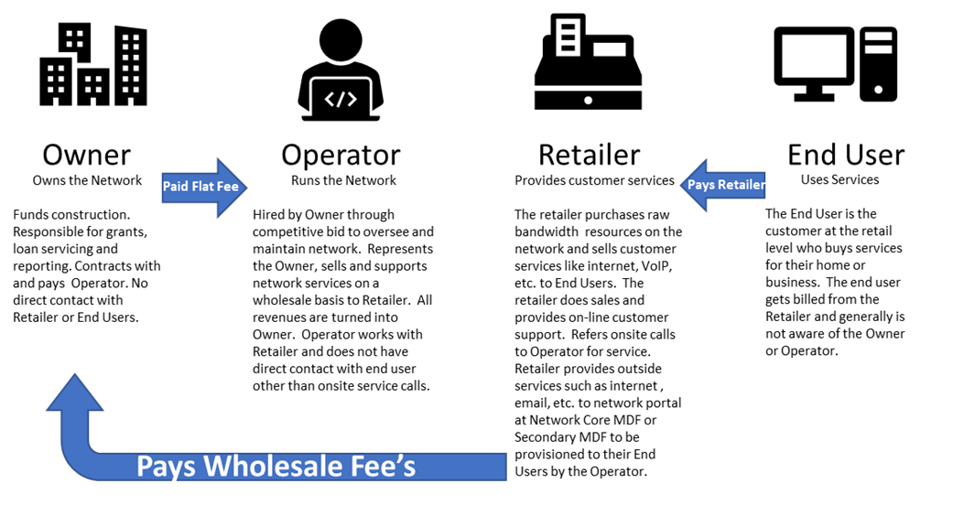
Open access network
Example: Community Owned “Open Access Network” flow structure

Slide 9
questions

