Slide 1
Affordable Connectivity Program Supermarket Program FCC Lisa Gustinelli-Innovator in Residence ASU Shaping EDU

Slide 2
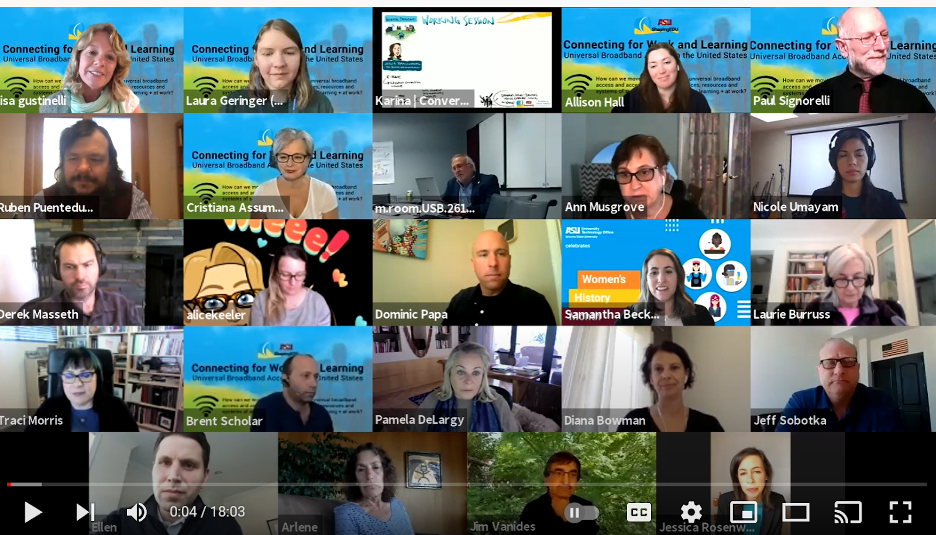
Timeline of Events February 2021-Call for stories from Consumers lacking access results in 60+ emails which we consolidated into a storybook. We now have confirmed that the lack of access is indeed hurting consumers' ability to work, learn, and access necessary services such as telemedicine only available to the connected. Storybook March 9-Broadband Meeting ASU Shaping EDU Broadband Access and Equity -meet with Jessica Rosenworcel Acting Chairwoman FCC Commissioner who introduces us to the FCC EBB program. We explain our initiative and JRosenworcel is especially interested in hearing about the stories we have collected.

Slide 3
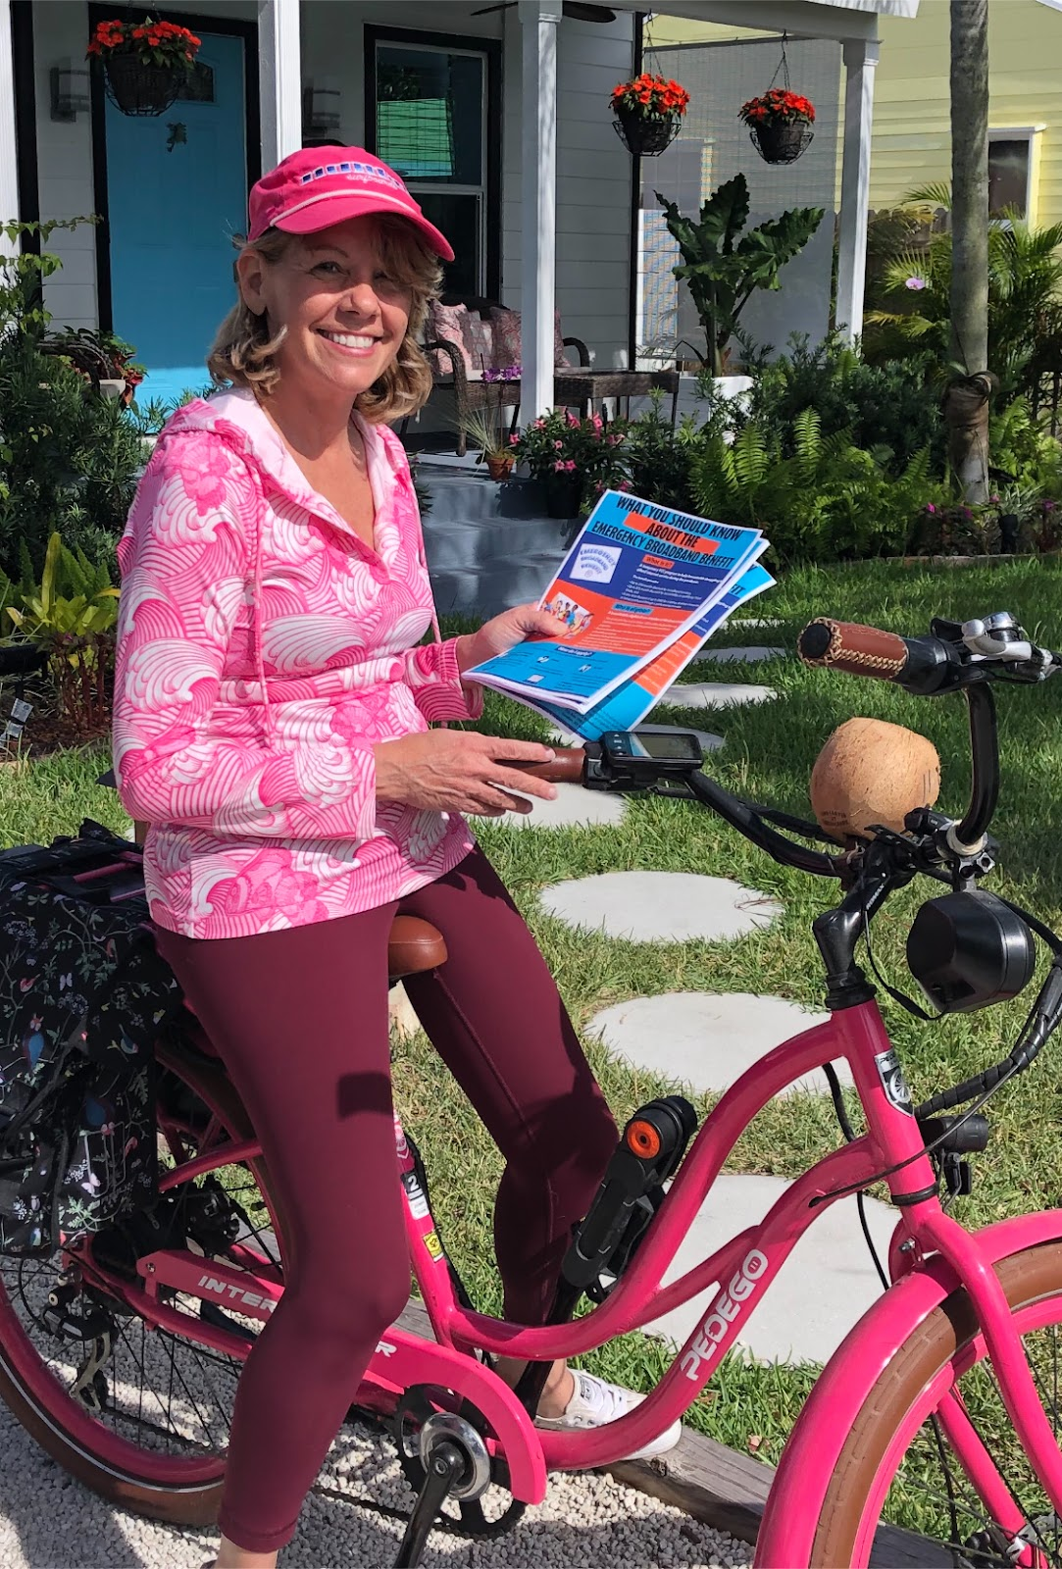
April-
As a result of our meeting with Jessica Rosenworcel, a link is added to the FCC
Website for collecting stories of consumers experiencing hardship due to lack of
broadband access.
May 4th- Broadband Meeting
Meet with Lyle Ishida, Chief, Consumer Affairs and Outreach Division,
Consumer & Governmental Affairs Bureau, Federal Communications Commission,
who discusses how the outreach effort is working. He leads us to the FCC website where we can
download flyers and posters for distribution

Slide 4
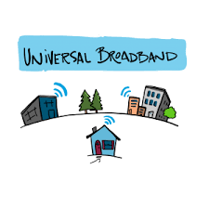
November 30- ASU Shaping EDU Broadband Meeting
Meet again with Lyle Ishida, who introduces us to the new FCC ACP program to be released in mid January. He explains the “supermarket program,” a program where grassroots activists will set up sign up kiosks for broadband.
December 2nd
Meet with Morana St. Hilaire of the Belle Glade Haitian Baptist church after-school program to distribute technology (iPads, laptops, a projector and screen). Morana explains his concern about the community of Belle Glade, where citizens cannot afford to be connected.

Slide 5
December 16 -Trust, trust, trust Arrange a meeting to connect Lyle Ishida and Morana St. Hilaire to start the first ACP in the U.S. Belle Glade will become a prototype for other small towns and impoverished areas.

Slide 6
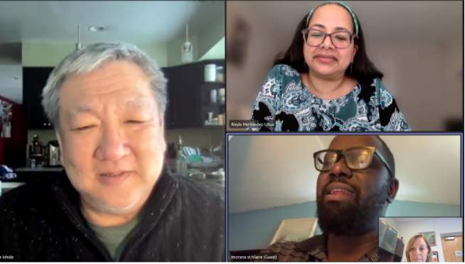
Program rollout
2022
January 7
Teams meeting with the following:
Lyle Ishida Chief, Consumer Affairs and Outreach Division
Consumer & Governmental Affairs Bureau
Federal Communications Commission
Keyla Hernandez-Ulloa
Associate Chief, Consumer Affairs and Outreach Division
Morana St. Hilaire
First Haitian Baptist Church Belle Glade, Florida

Slide 7
January 7, 2022
Meeting served to explain the ACP and discuss needs and setup:
*Households will receive $30.00 per month
They will also be eligible for up to $100 discount on devices (laptop, tablet, or mobile device)
The qualifying income is raised from 135% of income to 200% of family income in order to include the “working poor”
Flyers and documents for signup will be printed and sent via UPS or Fedex to the community leader
Minimum standard for devices
******During this meeting, the Chief of the FCC Consumer Affairs approves the distribution of materials and trainings for the city of Belle Glade, Florida

Slide 8
The numbers!
January 10th
Collection of numbers of supplies needed as well as households per zip code for data
Zip Codes-Zip codes in Red indicate those homes already connected with EBB
Belle Glade-33430 (1,024)
South Bay -33493 (196)
Pahokee-33476 (471)
For the Flyers it was recommended that we print approximately
10,000 flyers for each language group.
-- # of Haitian-Creole Flyers to print
-- # of Spanish Flyers to print
-- # of English Flyers to print
Notes:
First steps:
1.Connect lead activist to the FCC outreach representative
2. Explain the program and how it is implemented
3. Identify organizations and key outreach locations where a trainer can be put into place to give out information. * FCC will set up webinars to train the trainers in their native language
4. Design how the program will work
How often? Timeline-push in the beginning but then taper off to once a month
Where?
5. Determine numbers-how many flyers to be printed and in what languages
6. Where will the flyers be sent?
The main Navigator determines the local hub, gets the word out, sets up webinar times and places and organizes mailings
The main Navigator will provide Zip codes of consumers in order to start to collect data and follow the impact of the program.
If the Navigator hold events or is aware of partner events, they will share the information on social media with FCC press kits provided
Worth noting: Lyle Ishida has told us this is the first project of its kind under the expanded FCC broadband-access program. [Great example of us meeting our mandate of bringing key players together to promote the expansion of broadband, with the ultimate goal of supporting universal broadband throughout the United States.]

Slide 9
The Rules…..
Notes:
Let's think about creating a survey to add to our data (ie: telehealth before vs after)
January 21
Meet with Lyle Ishida, Keyla St. Hilaire, Gerard Willians
Rules define what ACP
The FCC is waiting for the order, although the legislation for funds has passed
They are sure that the rule of 30$ per month and 200% poverty level will not change and people can sign up, but “nothing is yet written in stone” The program exists by statute and by law.
They still need to define the directives of how individual providers will manage the program and how legal will operate. They don’t have all the details of the transition from EBB to ACP.
While they have received funding, they haven't set these rules yet. They are hoping by February 1st.
So…..
PRinted materials will be sent on Monday January 24.
Once rules are available, info can be collected for the train the trainer supermarket program. They don’t want to release the Powerpoint slides in case something changes.
The info for train the trainers will be available mid February.
Meanwhile, we will make another trip to Belle Glade on Feb 3rd to distribute more technologies, books and curriculum (this is part of relationship building)
It will be followed by a kickoff event with an FCC speaker.

