Slide 1
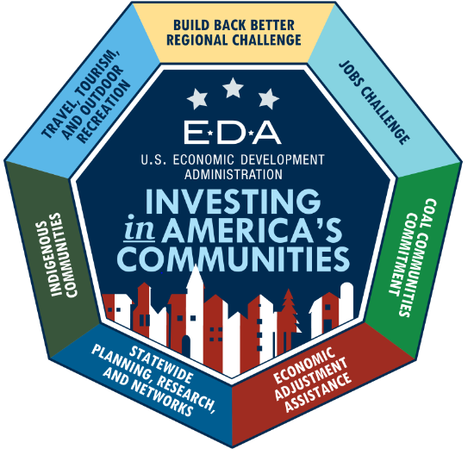
Economic Development Administration (EDA) American Rescue Plan INVESTING IN AMERICA’S COMMUNITIES

Slide 2
An Introduction to the Economic Development Administration (EDA)

Slide 3
EDA’s Mission
To lead the federal economic development agenda by promoting innovation and competitiveness, preparing American regions for growth and success in the worldwide economy.
Increase America’s global economic competitiveness
Support community-led economic development
Help communities develop resilient and agile local economies
3

Slide 4
EDA’s Investment Priorities
Recovery & Resilience
Workforce Development
Exports & Foreign Direct Investment
Equity
Manufacturing
Technology-Based Economic Development
Environmentally-Sustainable Development
To learn more about EDA’s Investment Priorities, visit: https://eda.gov/about/investment-priorities/
5
Notes:
Recovery & Resilience: Projects address business continuity and preparedness, long-term natural disaster recovery, and economic shocks to ensure U.S. communities are globally competitive.
Critical Infrastructure: The building blocks of a prosperous and innovative economy and a secure platform for American business. Examples include broadband, energy, roads, water, sewer, and other economic infrastructure.
Workforce Development & Manufacturing: Projects support infrastructure planning and implementation for skill-building and training facilities that address hiring needs of the business community. These include projects that encourage job creation and business expansion in manufacturing, including those that focus on advanced manufacturing of innovative, high-value products and manufacturing supply chains.
Exports & Foreign Direct Investment: Projects enhance community assets and infrastructure (e.g. port facilities) that lead to U.S. export growth, foreign direct investment, and ultimately the return of jobs to the United States.
Opportunity Zones: Planning and implementation projects attract private investment and Opportunity Funds to grow businesses and create jobs in Census tracts designated as Opportunity Zones.

Slide 5
EDA’s Program Portfolio
Economic Adjustment Assistance (EAA)
Public Works
Planning
Technical Assistance
Research and Evaluation
Trade Adjustment Assistance for Firms (TAAF)
Innovation and Entrepreneurship
Revolving Loan Funds (RLF)
Part of EAA
American Rescue Plan funds are EAA funds
6

Slide 6
EDA’s American Rescue Plan Grant Programs

Slide 7
$3 billion in American Rescue Act funding to Invest in America’s Communities
This historic investment will support bottom-up, economic development focused on advancing equity, creating good-paying jobs, helping workers to develop in-demand skills, building economic resilience, and accelerating the economic recovery for the industries and communities hit hardest by the coronavirus pandemic.
EDA investments made under the American Rescue Plan will support the Biden-Harris Administration’s commitment not just to build the American economy back to where it was before the pandemic, but to build back better and stronger.
8

Slide 8
Funding Commitments
EDA’s $300 million Coal Communities Commitment will ensure support for coal communities as they recover from the pandemic and create new jobs and opportunities.
25% of the $3B American Rescue Plan funds are dedicated to communities that suffered economic injury as a result of job and GDP losses in the travel, tourism, or outdoor recreation sectors.
10

Slide 9
NOFOs
Description
Total American Rescue Plan funding: $3B
Statewide Planning, Research, & Networks
Invest in economic plans, research to assess the effectiveness of EDA's programs, and support for stakeholder communities around key EDA initiatives
1
$90M
Build Back Better Regional Challenge
Transform 20-30 economically distressed regions through substantial investment through groups of 3-8 projects, totaling ~$25-75M per region; open to proposals up to $100M
2
$1B
3
Travel, Tourism, & Outdoor Recreation
$750M
Accelerate communities impacted by COVID-related travel and tourism decline through state grants ($510M) and competitive grants ($240M)
Economic Adjustment Assistance
Invest in infrastructure, technical assistance, planning, and revolving loan programs through competitive grants available to every community
4
$500M
Indigenous Communities
$100M
Additional Economic Adjustment Assistance funds to specifically support Indigenous communities
5
Good Jobs Challenge
Establish or strengthen regional systems to train workers with in-demand skills through employer-driven training, supporting participants with wrap-around services and employer commitments to hire
6
$500M
11

Slide 10
NOFOs
Description
Total American Rescue Plan funding: $3B
Statewide Planning, Research, & Networks
Invest in economic plans, research to assess the effectiveness of EDA's programs, and support for stakeholder communities around key EDA initiatives
1
$90M
Build Back Better Regional Challenge
Transform 20-30 economically distressed regions through substantial investment through groups of 3-8 projects, totaling ~$25-75M per region; open to proposals up to $100M
2
$1B
$100M
3
Travel, Tourism, & Outdoor Recreation
$750M
Accelerate communities impacted by COVID-related travel and tourism decline through state grants ($510M) and competitive grants ($240M)
Economic Adjustment Assistance
Invest in infrastructure, technical assistance, planning, and revolving loan programs through competitive grants available to every community
4
$500M
$200M
Indigenous Communities
$100M
Additional Economic Adjustment Assistance funds to specifically support Indigenous communities
5
Good Jobs Challenge
Establish or strengthen regional systems to train workers with in-demand skills through employer-driven training, supporting participants with wrap-around services and employer commitments to hire
6
$500M
$300M Coal Communities Commitment
12
Visit our website for more information

Slide 11
Statewide Planning, Research, & Networks $90 million
Invest in economic plans, research to assess the effectiveness of EDA's programs, and support stakeholder communities around key EDA initiatives
Statewide Planning: $59M
Research & Networks: $31M
$1 million planning grants to each state and territory
Research & Evaluation: Fund projects to study the implementation of EDA’s American Rescue Plan programs; identify valuable strategies, data, and trends; and inform future EDA grant-making
Communities of Practice: Fund the launch and operations of communities of practice across key groups of EDA stakeholders (UCs, RLFs, EDDs, etc.) and other American Rescue Plan programs (Build Back Better Regional Challenge, Good Jobs Challenge, etc.)
13

Slide 12
Build Back Better Regional Challenge
$1 Billion
Services Cluster
($50M)
Transform economically distressed communities through substantial investment in regional growth clusters
Capitol city
Mid-size coastal town
Major
city
University town
Proposals should include regional coalitions, industry support, and high-impact projects with a shared vision for a regional growth cluster
One key coordinating entity per region
3-8 projects per regional cluster
$100M to the Coal Communities Commitment
Manufacturing Cluster
($80M)
Major city
Entrepreneurship Cluster ($25M)
Major city
Capitol
city
Mid-size town
Major industrial town
University town
Transportation hub
Small industrial town
Projects can include:
Planning | Infrastructure | Workforce | Entrepreneurship
14
Notes:
Voiceover should provide examples of past EDA regional investments and that it took many years and was at a much smaller scale. BBB will “supercharge” these regional efforts, focus on projects at much higher dollar amounts, and be on a limited timeline.

Slide 13
Build Back Better Regional Challenge Two-Phased Approach
Phase I: 50-60 regions awarded
technical assistance grants to finalize plans for project clusters
Total: ~$500,000 per region
$100M Coal Communities Commitment
Phase II: 20-30 regions from Phase I regions awarded implementation grants from full project cluster applications
Total: ~$25-$100M
per region
15

Slide 14
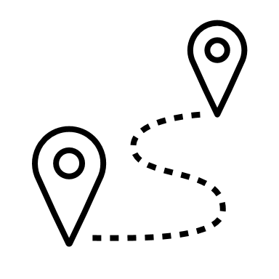
Travel, Tourism, & Outdoor Recreation $750 million
Accelerate communities impacted by COVID-related travel and tourism decline through block grants to states and competitive grants
State Grants: $510M
Challenge: $240M
Award allocations to each state and territory based on economic development indicators in the leisure and hospitality industries
Can fund destination marketing, but cannot fund economic diversification projects
Assist communities that suffered economic injury because of job losses in travel, tourism, or outdoor recreation sectors
EDA prefers projects that directly support the travel, tourism, and outdoor recreation sectors; but will consider diversification projects
Cannot fund local destination marketing
16

Slide 15
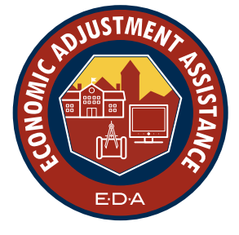
Economic Adjustment Assistance $500 million
Invest in infrastructure, technical assistance, planning, and revolving loan programs through competitive grants available to every community
Most flexible American Rescue Plan program; intended to fund non-construction and construction activities not already part of another Notice of Funding Opportunity (NOFO).
A wide range of technical, planning, workforce development, entrepreneurship, and public works and infrastructure projects are eligible for funding under this program.
EDA encourages application submissions based on long-term, regionally oriented, coordinated, and collaborative economic development or redevelopment strategies that foster economic growth and resilience. This includes plans aimed at building stronger regional economic links between urban centers and rural areas.
$200M Coal Communities Commitment
17

Slide 16
Indigenous Communities $100 million
Develop projects designed to create the conditions for economic growth in Indigenous communities and to accelerate economic recovery from the pandemic
Additional $100 million in Economic Adjustment Assistance funds will specifically support Indigenous communities and can be used to fund nontraditional EAA projects, like health centers
A wide range of technical, planning, workforce development, entrepreneurship, and public works and infrastructure projects are eligible for funding under this program
This competition is open only to Indian Tribes, as defined in EDA’s regulations, nonprofits serving Native Hawaiians, and nonprofits serving Native Pacific Islanders
18

Slide 17
Good Jobs Challenge $500 million
Get Americans back to work by establishing or strengthening regional systems to train workers with in-demand skills through employer-driven training models that support participants with wrap-around services and employer commitments to hire
System Development
Funding to help an organization establish and develop workforce systems and sectoral partnerships
Program Design
Funding to develop skills training curriculum and materials, secure technical expertise to train workers, and secure employer commitments to hire
Program Implementation
Funding for non-construction projects to provide workforce training and connect workers with quality
jobs, including wrap-around services
19

Slide 18
Good Jobs Challenge $500 million
Get Americans back to work by establishing or strengthening regional systems to train workers with in-demand skills through employer-driven training models that support participants with wrap-around services and employer commitments to hire
Beneficiaries: unemployed or underemployed workers from underserved communities, incumbent workers from underserved communities with opportunity for upskilling and increased wages
Capital expenses, such as equipment purchase and training facility leases, are permitted. However, construction activities are not allowable; any workforce program that requires construction can and should apply to other NOFOs, such as the Economic Adjustment Assistance NOFO
Disbursement of funds gated upon successful completion of each phase of workforce program development benchmarks
System Development
Program Design
Program Implementation
20

Slide 19
Thinking Big at EDA
American Rescue Plan programs will address larger projects than before. This gives EDA the opportunity to transform communities across the country.
American Rescue Plan programs will expand EDA’s reach. EDA will engage with and impact more communities and support an equitable recovery.
EDA will help Americans build back better through community-led economic development.
21
Notes:
REMINDER: engage@eda.gov is an internal email address, and is not for intake of public/stakeholder questions.

Slide 20
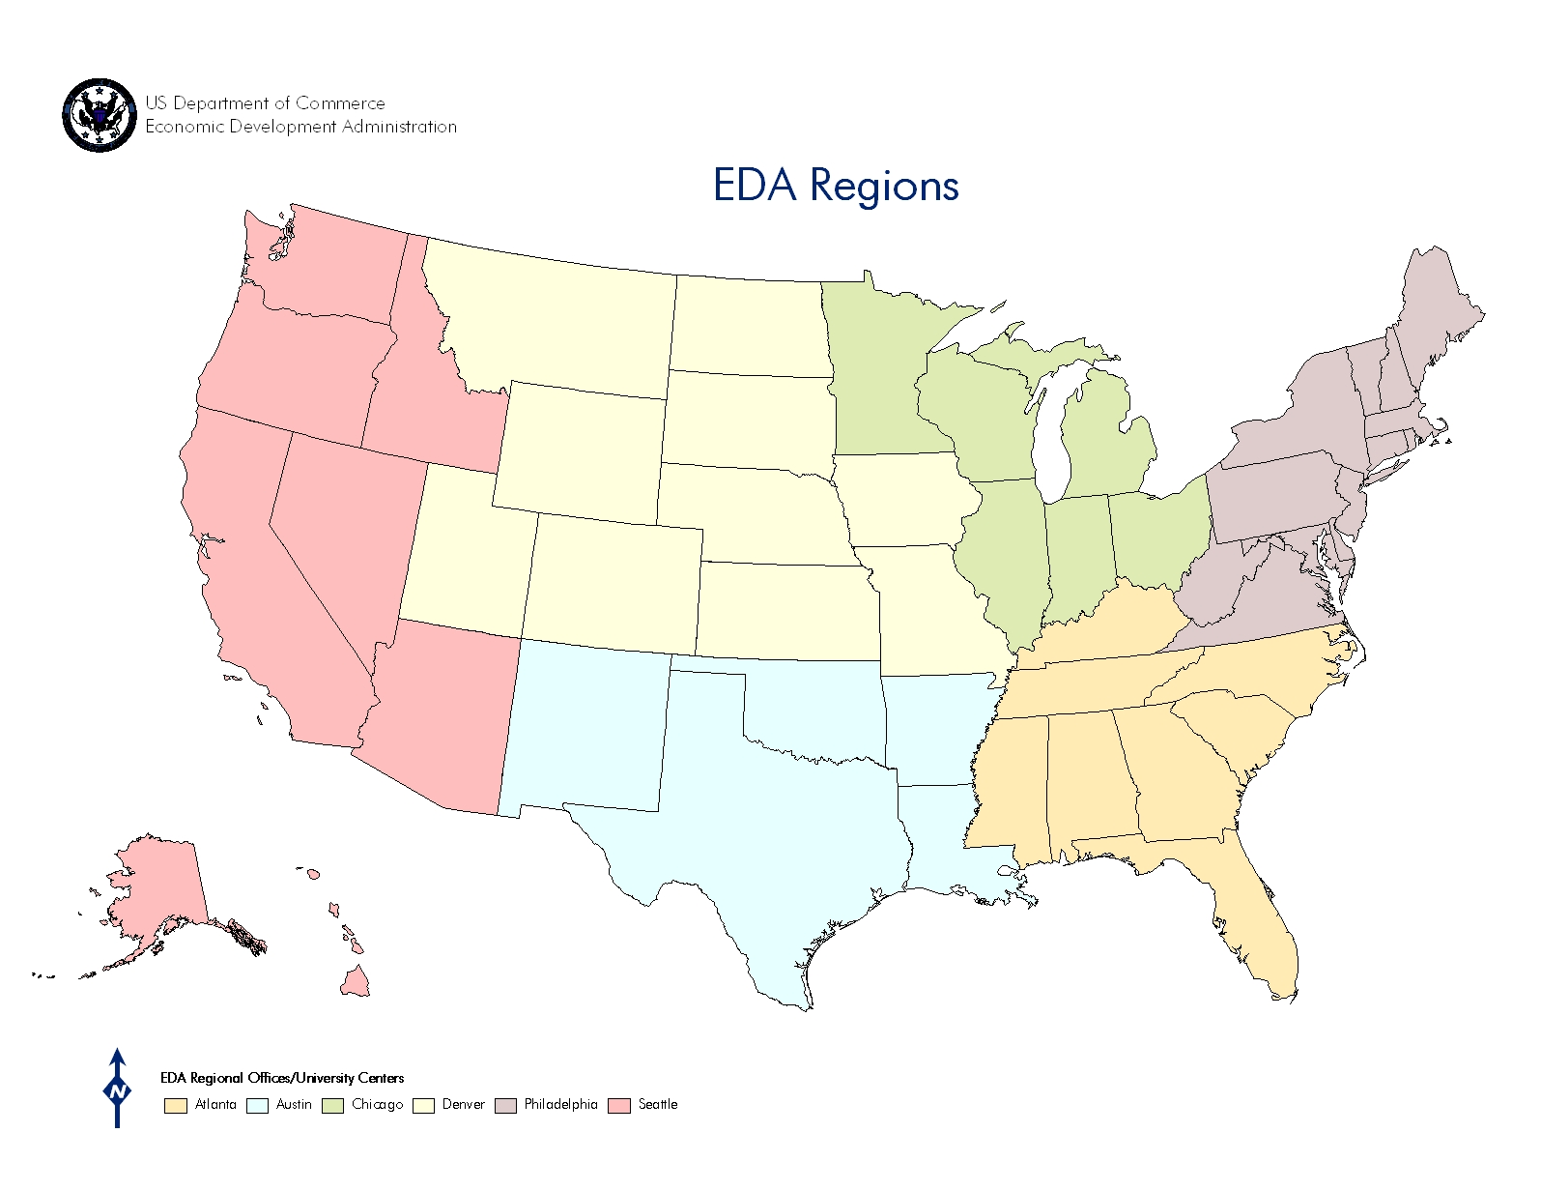
Next Steps to Apply
Read the Notice of Funding Opportunity (NOFO) and Eligibility Requirements for each program: https://eda.gov/funding-opportunities/
Find your Economic Development District for planning support and technical assistance: https://eda.gov/resources/directory/
Connect with your state’s Economic Development Representative with questions: https://eda.gov/contact
SEATTLE
CHICAGO
Seattle:
American Samoa
Guam
Federated States of Micronesia
Palau
Marshall Islands
Commonwealth of the Northern Mariana Islands
PHILADELPHIA
DENVER
ATLANTA
AUSTIN
Philadelphia:
Puerto Rico
U.S. Virgin Islands
22
Notes:
REMINDER: engage@eda.gov is an internal email address, and is not for intake of public/stakeholder questions.

Slide 21
Resources
Visit our website for resources: www.eda.gov/arpa
One-page overviews
NOFO webinars
FAQs
Applicant support tools
23
Notes:
REMINDER: engage@eda.gov is an internal email address, and is not for intake of public/stakeholder questions.

Slide 22
Questions?
Visit www.eda.gov/arpa to learn more about the American Rescue Plan programs and find contact information for each.

