Slide 1

AZBSN Arizona Broadband Stakeholder Network
Monday 22 March 2021
Glen Lineberry

Slide 2
The challenge
One in five American students are located in rural counties (Robson et al., 2019) where recruiting and retaining highly qualified teachers means schools are unable to offer the rigorous and relevant curriculum students need to succeed at university.

Slide 3
This is not new & it’s getting worse
Maintaining a qualified faculty is not a new problem for rural districts and research statistics tend to lag (McHenry-Sorber & Campbell, 2019), but Arizona’s newspaper of record reports more than one-fifth of K-12 classrooms lack an appropriately certified teacher (Allhands, 2019), a problem that worsened the following year (Altavena, 2019) and has been further exacerbated by COVID-19 (Altavena, 2020).

Slide 4
The impact on rural students is devastating
Small rural schools in the United States are often unable to recruit and retain highly qualified teachers to offer the full range of courses required for graduates to matriculate successfully at university (Miller et al., 2019). Students need additional resources such as advanced courses in order to succeed after graduating, but those courses are difficult for many rural schools to staff and to fund (Feygin et al., 2019).

Slide 5
The problem is acute in Arizona
The nationwide problem is borne out by data specific to Arizona indicating half of Arizona high school graduates lack the credits required by the state’s three universities (Hickman et al., 2020), continuing a trend previously identified by the Arizona Board of Regents (ABOR, 2015).

Slide 6
and the anecdotal evidence is even worse
Every principal and superintendent contacted by AzSOC reported students lacked access to critical courses, and the list of missing courses changes from year to year. The courses most difficult to staff are 10th-grade Biology, upper-level math and science, Spanish, dual enrollment courses, and CTE.

Slide 7
No solution is on the horizon, so we have undertaken to solve this problem ourselves.

Slide 8
The idea is simple
I have teachers at Miami with master’s degrees in math & English.
Globe has teachers with master’s in Spanish & history.
San Carlos has a chemistry Ph.D.
Why can’t our kids all benefit from each school’s underutilized & highly qualified teachers by exchanging instruction online?

Slide 9
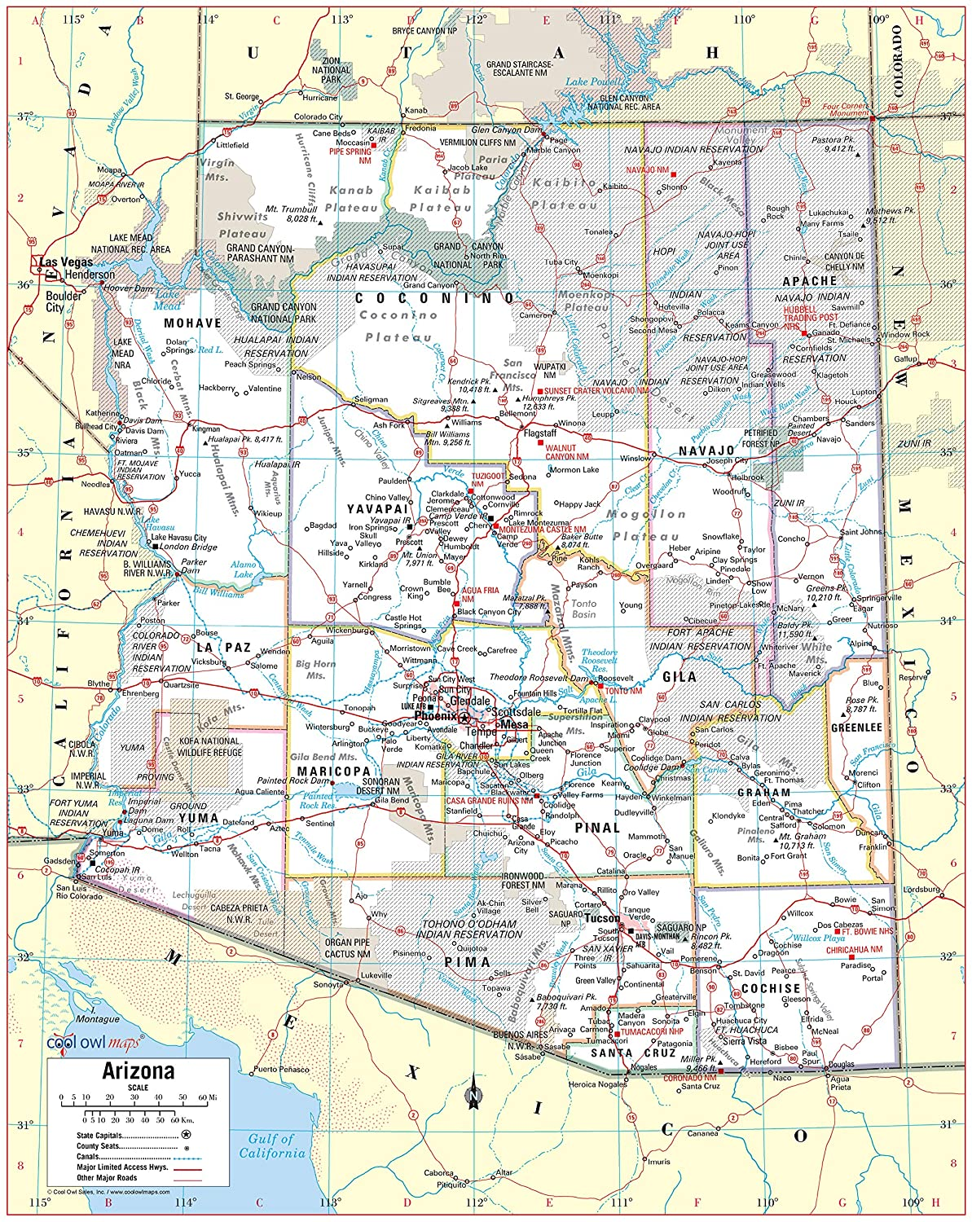
Like a group of musicians lacking a shared score
Every school has classes they cannot teach
Every school has a teacher underutilized in their content area
The Canvas learning management system permits asynchronous instruction, eliminating the need to align bell schedules
Zoom permits face-to-face instruction over any distance
AzSOC matches available teachers across rural Arizona to students who need classes to graduate high school or to matriculate successfully at university

Slide 11

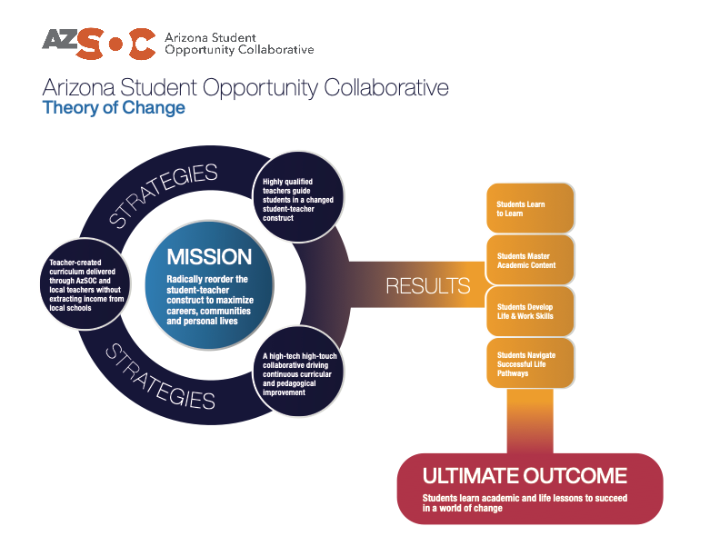

Slide 12
We have been generously supported
Dean Carole Basile of ASU’s Mary Lou Fulton Teachers College convened a planning session of educational, political and industry leaders in February 2019
ASU’s Office of Scholarship & Innovation
Yavapai County Superintendent Tim Carter placed organizational support at our disposal
The Helios Education Foundation is underwriting our entire budget
State Superintendent Kathy Hoffman has supported us at every turn
The Arizona Rural Schools Association and the National Rural Education Association are working closely with us

Slide 13
And we are teaching children
In our first year of full operation, more than 1300 enrollments in a range of courses, all taught by highly qualified teachers serving in rural Arizona schools
English | Math | Science | Social Studies | CTE Programs
English 7 | Math 7 | Science 7 | History 7 | Graphic Design
English 8 | Math 8 | Science 8 | History 8 | Journalism
English 9 | Algebra I & II | Physics 9 | World History | Education
English 10 | Geometry | Earth Science | US History | Business
English 11 | Trigonometry | Biology | Government | Law & Public Safety
English 12 | PreCalculus | Anatomy | Economics | Software & App Development
College English | Calculus I & II | Chemistry | World Conflicts
Novels & Film | Statistics | Physics
Spanish I & II | College Algebra
 | Technical Math

Slide 14
We’re very much on a steep learning curve
Finding the right blend of asynchronous availability and teacher touch
Growing flexibly as students’ and schools’ needs change term to term
Developing strong curricula to be delivered online
Finding permanent funding without impacting school budgets
Connecting all rural students with reliable, high-speed internet connectivity at school and at home
Finding and collaborating with partners across the country

Slide 15
Long Term Outcomes
Students graduate having mastered the academic and life lessons they need to be self-directed learners, economically productive and responsible citizens.
Otherwise underutilized teachers remotely guide a high-tech, high-touch learning collaboration that helps students maximize their academic, vocational and avocational potentials.
Teachers create rigorous and engaging curriculum directly responsive to the academic needs and cultural realities of the students they serve.
A robust instructional network levels the playing field by driving continuous improvement for all students without extracting revenue from local schools.

Slide 16
References
ABOR. (2015, September 17). New study indicates less than half of Arizona’s high-school graduates eligible for admission to Arizona’s public universities. Arizona Board of Regents News Release. https://www.azregents.edu/sites/default/files/public/
Allhands, J. (2019, October). Is Arizona’s teacher shortage getting better or worse? Here’s what the data tell us. The Arizona Republic. https:www.azcentral.com
Altavena, L. (2019, June). Squeezed by declining enrollment, Arizona’s rural schools are suffering. The Arizona Republic. https://www.azcentral.com
Altavena, L. (2020, September 17). Survey: 751 Arizona teachers have resigned or retired since the beginning of the school year. The Arizona Republic. https://www.azcentral.com
Feygin, A. R., Guarino, N. I., & Pardo, M. (2019). The postsecondary education and employment pathways of Minnesota public high school graduates: Investigating opportunity gaps. (REL 2019-011). Us Department of Education, Institute of Education Sciences, National Center for Education Evaluation and Regional Assistance, Regional Educational Library Midwest.
Hickman, G., Nwosu, K. C., & Camper, G. (2020). The predictive nature of mentoring student academic progress, mentor educational background, and mentor tenure among high school dropouts who graduated from an educational management organization. Journal of At-Risk Issues, 23(1), 15-24.
McHenry-Sorber, E., & Campbell, M. P. (2019). Teacher shortage as a local phenomenon: District leader sensemaking, responses, and implications for policy. Education Policy Analysis Archives, 27(87). https://doi.org/10.14507/epaa.27.4413
Miller, N., Elder, A., Seymour, D., Dekota, A., & Brenner, D. (2019, Spring). Teacher recruitment for an alternate route program in a rural area – Methods and lessons. Journal of the National Association for Alternative Certification, 14(1).
Robson, K., Burgoyne-Allen, P., Squire, J., & Schulz, J. (2019, December). Wide-Open Spaces: Schooling in Rural America Today. Bellwether Education Partners.

Slide 17

Questions?
Glen Lineberry
glen.lineberry@azsoc.org
480.329.3677

